Slide 1
Indeed Job Data
Project 4

Slide 2
Overview
Objective
Data Set
Cleaning/Set Up Data
Model/Projections
Data Table
Coefficients
Considerations
ROC Curve

Slide 3
Objective
Create a model to determine if certain words in a title results to a higher salary

Slide 4
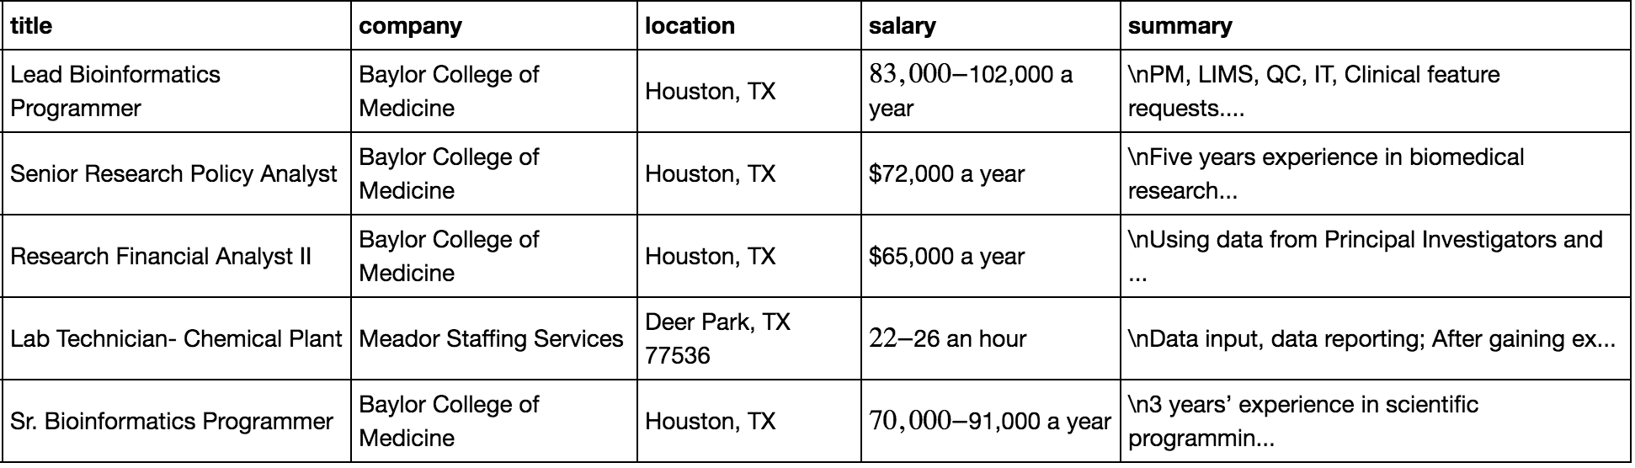
Data Set
Indeed Web Scrap
1000 urls
# of records with salaries: 155
Non-duplicates records: 98
Data columns
Title
Company
Location
Salary
summary

Slide 5
Cleaning/Set Up Data
Dummy Variables
Features: Analyst, Scientist, Data
Exists in “title”
1 = Yes, 0 = no
Features: Location
Eliminated city and used state
1 = Yes, 0 = no
Prediction: Salary
Sample median = 85,000
High >85,000, Low<85,000
1 = High, 0 = Low

Slide 6
Model/Projections
Projections used Logistic Regression
Variables Used for Prediction
Features: Analyst Scientist Data
Location
Test Train Split Test size = 0.33
Logistic Regression Model

Slide 7
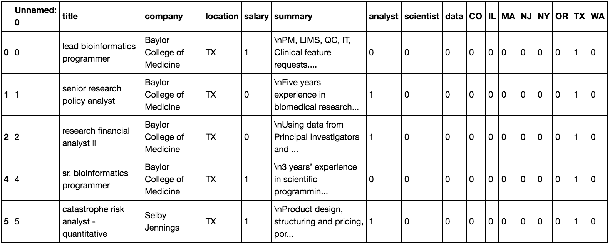
Data Table

Slide 8
Coefficients
Feature | Coefficients
Analyst | -0.26330508
Scientist | 0.61459557
Data | 0.31049492
CO | -0.74835978
IL | 0.20778164
MA | 1.12632679
NJ | 0
NY | 1.14204369
OR | -0.98871139
TX | 0.25987582
WA | -0.63529352

Slide 9
Considerations
Small sample size: 98 records
Not all cites presented evenly
City | # of Records
NY | 34
IL | 18
MA | 17
TX | 11
WA | 8
OR | 5
CO | 4
NJ | 1

Slide 10
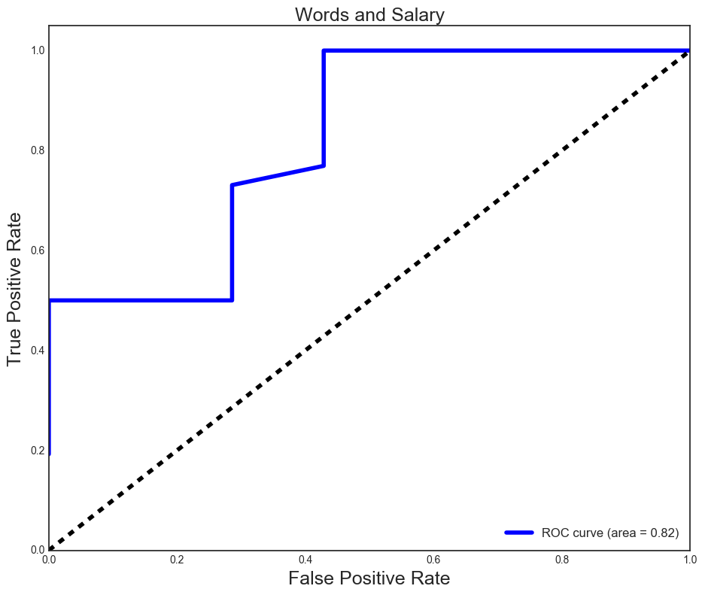
ROC Curve

